Slide 1
Assignment 2
Topic Modeling and Text Generation
By Vamsi Chinta, Faraz Mirza, & Alex Benitez

Slide 2
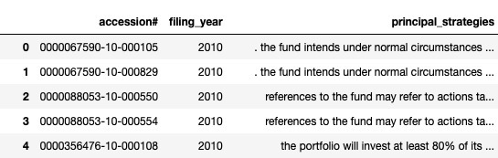
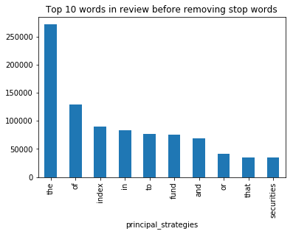
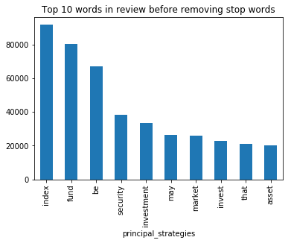
Input Data
3 columns
['accession#', 'filing_year', 'principal_strategies']
~6,200 rows
Time Frame of 2010 to 2018
410 null rows
4331 unique terms after cleaning
Original Dataset

Slide 3
Part 1:
Topic Modeling using LDA

Slide 4
PreProcessed Data
Lower case
Removed punctuation
Tokenized sentences
Removed stop-words
Lemmatization [noun, adj, verb, & adverb]
Created the dictionary
Created the corpus

Slide 5
The LDA Model
Optimization
Optimal Parameters
Removed words that were common in all topics from input data
Iterated over ‘# of Topics’:
Shrinking Range of 0-200
Shrinking Step size Range of 1-50
Growing range for # of Passes of 5-50
# of Topics = 12
Coherence Score = 0.42
Log-Likelihood Score = -6.0
Notes:
The chunksize
controls how many documents are processed at a time in the training algorithm. Increasing chunksize will speed up training, at least as long as the chunk of documents easily fit into memory. I've set chunksize = 2000, which is more than the amount of documents, so I process all the data in one go. Chunksize can however influence the quality of the model, as discussed in Hoffman and co-authors [2], but the difference was not substantial in this case.
passes
controls how often we train the model on the entire corpus. Another word for passes might be "epochs". iterations is somewhat technical, but essentially it controls how often we repeat a particular loop over each document. It is important to set the number of "passes" and "iterations" high enough.
The relationship between chunksize, passes, and update_every is the following:
passes: Number of passes through the entire corpus
chunksize: Number of documents to load into memory at a time and process E step of EM.
update_every: number of chunks to process prior to moving onto the M step of EM.

Slide 6
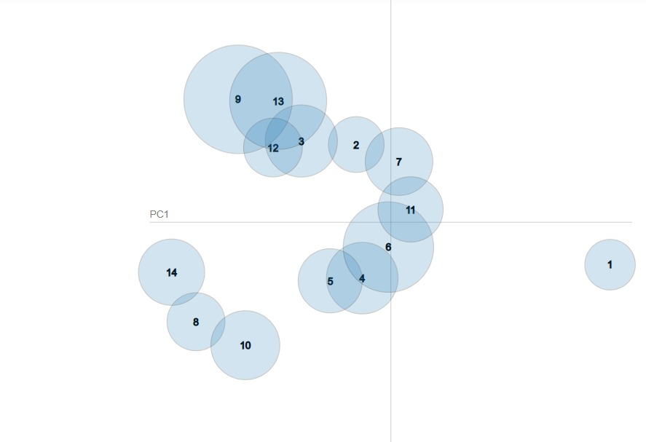
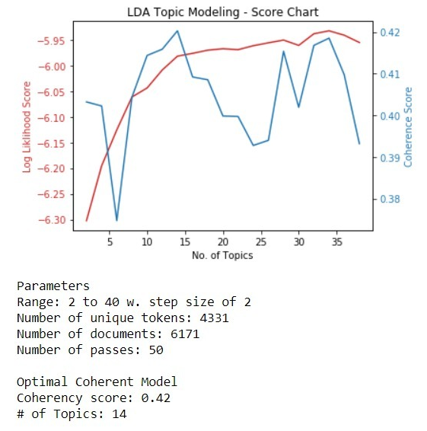
Performance
Score Chart

Slide 7
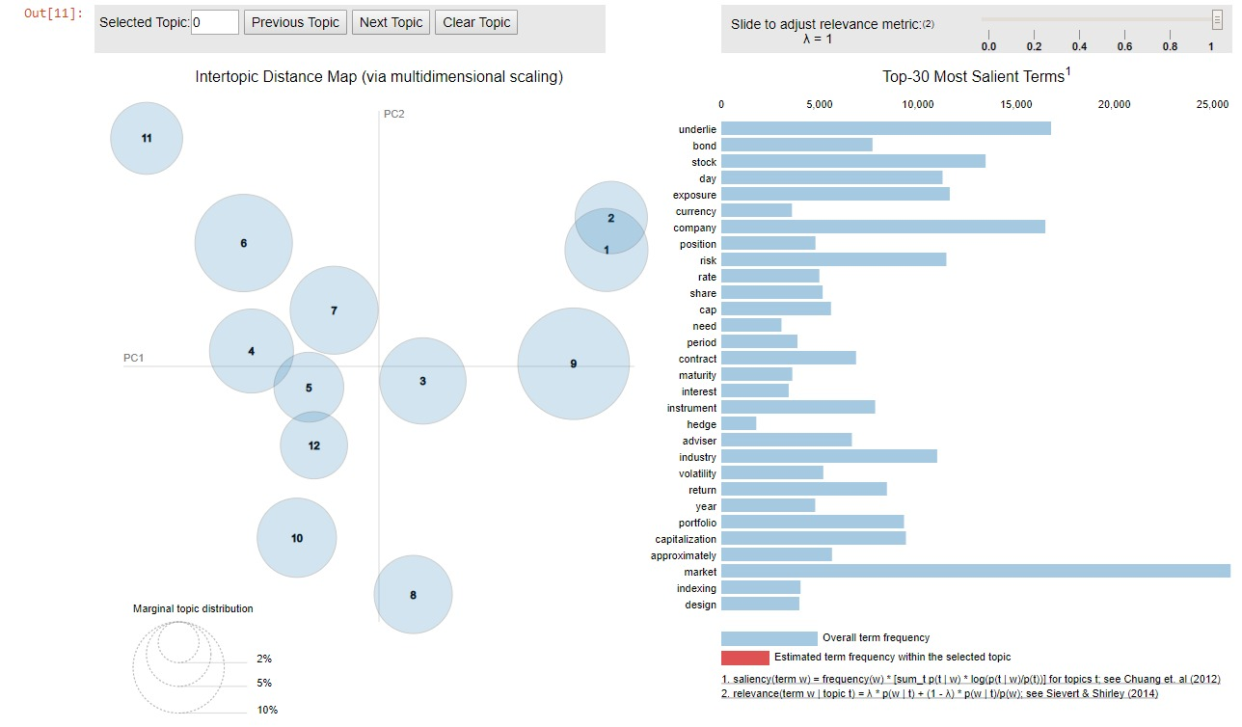
Performance
Bubble Visualization
The model at 12 topics is more well distributed and separated with high value of coherence score.

Slide 8
Part 2:
Dynamic Topic Modeling using LDA

Slide 9
The DTM Model
Optimization
Optimal Parameters
Corpus & dictionary from part 1 was used for part 2
Iterated over ‘# of Topics’:
Shrinking Range of 0-200
Shrinking Step size Range of 1-50
Growing range for # of Passes of 5-50
# of Topics = 12
Notes:
The chunksize
controls how many documents are processed at a time in the training algorithm. Increasing chunksize will speed up training, at least as long as the chunk of documents easily fit into memory. I've set chunksize = 2000, which is more than the amount of documents, so I process all the data in one go. Chunksize can however influence the quality of the model, as discussed in Hoffman and co-authors [2], but the difference was not substantial in this case.
passes
controls how often we train the model on the entire corpus. Another word for passes might be "epochs". iterations is somewhat technical, but essentially it controls how often we repeat a particular loop over each document. It is important to set the number of "passes" and "iterations" high enough.
The relationship between chunksize, passes, and update_every is the following:
passes: Number of passes through the entire corpus
chunksize: Number of documents to load into memory at a time and process E step of EM.
update_every: number of chunks to process prior to moving onto the M step of EM.

Slide 10
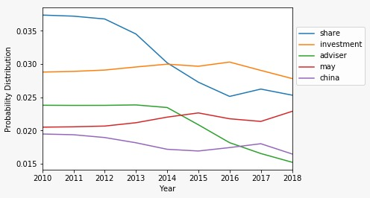
Performance
Key Word Probability Plot
Top five terms by probability at sampled time slice for Topic 0 from 2010 to 2018

Slide 11
Part 3:
Topic Modeling using LDA2Vec
Notes:
To do:
Read about Lda2Vec

Slide 12
The LDA2Vec Model
Optimization
Optimal Parameters
Iterate over # of Topics:
Window size [2-4]
Batch size [150-300]
# of Epochs [100,000 - 200,000]
Vector Dimension [50-100]
Loss Functions
Word2Vec = Binary CrossEntropy
LDA = Dirichlet Likelihood
# of Topics = 3
Batch size = 150
Window size = 2
# of Epochs = 200,000
Vector Dimension = 100
Notes:
The chunksize
controls how many documents are processed at a time in the training algorithm. Increasing chunksize will speed up training, at least as long as the chunk of documents easily fit into memory. I've set chunksize = 2000, which is more than the amount of documents, so I process all the data in one go. Chunksize can however influence the quality of the model, as discussed in Hoffman and co-authors [2], but the difference was not substantial in this case.
passes
controls how often we train the model on the entire corpus. Another word for passes might be "epochs". iterations is somewhat technical, but essentially it controls how often we repeat a particular loop over each document. It is important to set the number of "passes" and "iterations" high enough.
The relationship between chunksize, passes, and update_every is the following:
passes: Number of passes through the entire corpus
chunksize: Number of documents to load into memory at a time and process E step of EM.
update_every: number of chunks to process prior to moving onto the M step of EM.

Slide 13
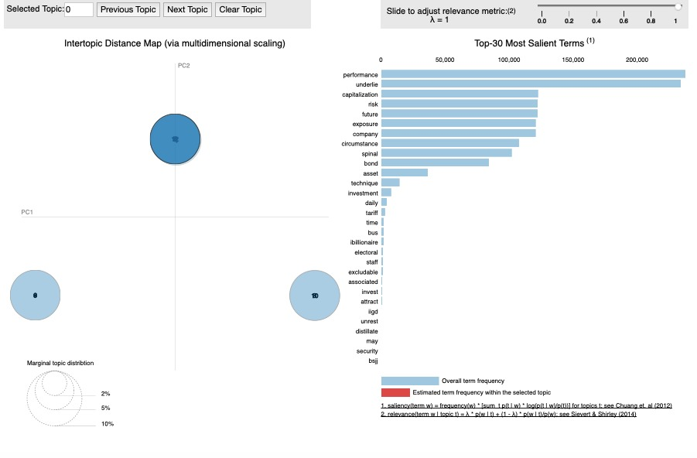
Performance Comparison
LDA2Vec
LDA
LDA2Vec classified our documents to a particular topic better than our LDA model

Slide 14
Part 4:
Text Generation using LSTM

Slide 15
The LSTM Model
Optimization
Optimal Parameters
Word vs. Character Based LSTM
Window size = avg[# of characters per sentence]
# of Epochs
Batch Size
# of LSTM layers
# of Drop-Out layers
Activation layers
Character-Based LSTM
Activation layer = Softmax
Window size = 120
# of LSTM layers = 2
# of Drop-Out layers = 2
# of Epochs = 20
Batch Size = 128
Notes:
The chunksize
controls how many documents are processed at a time in the training algorithm. Increasing chunksize will speed up training, at least as long as the chunk of documents easily fit into memory. I've set chunksize = 2000, which is more than the amount of documents, so I process all the data in one go. Chunksize can however influence the quality of the model, as discussed in Hoffman and co-authors [2], but the difference was not substantial in this case.
passes
controls how often we train the model on the entire corpus. Another word for passes might be "epochs". iterations is somewhat technical, but essentially it controls how often we repeat a particular loop over each document. It is important to set the number of "passes" and "iterations" high enough.
The relationship between chunksize, passes, and update_every is the following:
passes: Number of passes through the entire corpus
chunksize: Number of documents to load into memory at a time and process E step of EM.
update_every: number of chunks to process prior to moving onto the M step of EM.

Slide 16
Performance
Seed: ‘jective the impact o’
Generated Text: ‘f the index’s movements during the day will affect whether the fund’s portfolio needs to be’
Seed: ‘nvestments plus capi’
Generated Text: ‘tal appreciation if any which generally arises from decreases in real interest rates and in the’
Seed: ‘normal circumstanc’
Generated Text: ‘es creates short positions by investing at least 80 of its net assets plus any borrowings for invest’
Seed: ‘use a significant po’
Generated Text: ‘rtion of the assets of the fund should rise meaning that the fund’s exposure will need to be increase’

Slide 17

Questions & Answers

Slide 18
Appendix

Slide 19
Term Dictionary
Topic Modeling
The general goal of a topic model is to produce interpretable document representations which can be used to discover the topics or structure in a collection of unlabelled documents.
LDA
Latent Dirichlet Allocation (LDA) is a probabilistic topic model and it treats documents as a bag-of-words
Coherence Metric
Based on a sliding window, one-set segmentation of the top words and an indirect confirmation measure that uses normalized pointwise mutual information (NPMI) and the cosine similarity

